Slide 1
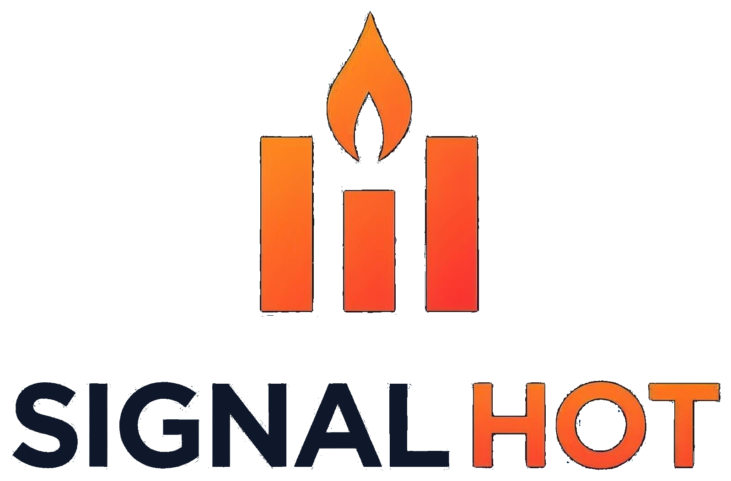
For customer success and support teams
Product Overview
AI signals platform for customer churn, escalation, success, and growth
Four pillars
What it does
Differentiators
Integration
Security
Plans

Slide 2
CORE FUNCTIONALITY
Four pillars — each a signal and an action.
The model detects it; the AI agent recommends the next step.
Churn Risk
Who is at risk of leaving
Escalation
Which cases will escalate
SIGNAL
SIGNAL
Risk index per account — CSAT, case pressure, engagement, value, renewal.
Composite risk index per case — priority, SLA, sentiment, aging, activity.
AI AGENT
AI AGENT
Recommends the retention step and drafts the outreach.
Recommends the response and drafts the exec brief before a case escalates.
Success
Who can be a reference
Growth
Where expansion is likely
SIGNAL
SIGNAL
Recognition index — Champions across customers, contacts & staff.
Expansion index — ML matches product gaps to needs, weighted by industry.
AI AGENT
AI AGENT
Recommends the reference or renewal ask, and drafts it.
Recommends the next product and drafts the pitch.
signalhot.com
2 / 7

Slide 3
WHAT SIGNALHOT DOES
Which customers need you today?
Your support data is signalling.
AI signals platform for customer churn, escalation, success, and growth
What it does
What it needs
What it is not
Monitors every case and customer
The support data you already have
Not a helpdesk
Hourly, or on a schedule you set
Read-only connection
Not a system of record
Shows why each was flagged
No new tooling or process change
No change to how your agents work
Recommends the next action
Built on Google Cloud · Read-only. SignalHOT never writes to your systems.
signalhot.com
3 / 7

Slide 4
WHERE SIGNALHOT DIFFERS
Four signals, one platform.
And it learns from your outcomes.
Where SignalHOT differs from the customer success platforms
Four pillars, not one
Models that learn
Churn, escalation, success and growth run on the same data, on the same schedule.
Churn and growth weights are retuned from the outcomes you record.
Elsewhere: churn only, with expansion left to the CRM.
Elsewhere: fixed weights, set once at implementation.
Every flag is explained
Live in days
Each one shows its contributing factors and the recommended next action.
A read-only connection to the systems you already run. No rollout, no training.
Elsewhere: a health number with no visible reasoning.
Elsewhere: a three to six month implementation.
signalhot.com
4 / 7

Slide 5
INTEGRATION APPROACH
One read-only connection.
Nothing flows back.
What we connect to, what we read, and how often
YOUR SYSTEMS
WHAT SIGNALHOT READS
Zendesk
READ ONLY
Cases
Accounts
Salesforce
Case comments
Contacts
ServiceNow
CSAT responses
Support staff
Incremental
Custom API
Set up by your admin.
No attachments, no agent screens, no billing data.
You choose the sync cadence
Only what changed
Nothing is written back
Hourly, every six or twelve hours,
daily, or on demand.
After the first run each sync collects changes since the last one.
No tickets, fields or comments are created or changed in your systems.
Credentials are encrypted at rest and can be revoked from your side at any time.
signalhot.com
5 / 7

Slide 6
DATA PRIVACY AND SECURITY
Your data stays yours. Here is exactly how.
How your data is separated, encrypted, accessed, and processed
Tenant isolation
Encryption
Every record is scoped to one tenant, enforced at the API layer
TLS in transit, encrypted at rest on Google Cloud
No customer account can reach another tenant's data
Connector credentials encrypted with a separate key
Access control
AI processing
Named accounts and roles. New users need admin approval
Signals are detected inside SignalHOT
Sessions expire after eight hours
Anthropic's API writes the drafts, and does not train on them
Read-only connectors
Deletion on request
Daily backups with point-in-time recovery
Hosted on Google Cloud in the United States. Other regions on request.
signalhot.com
6 / 7

Slide 7
PLANS AND PRICING
Four plans.
One platform.
Every plan includes all four pillars, their AI agents and the connectors. Annual pricing shown.
Starter
Professional
Enterprise
Custom
$1,249
$2,499
$3,999
Let's talk
/mo billed annually
/mo billed annually
/mo billed annually
$1,499 monthly · setup = 1 month
$2,999 monthly · setup = 1 month
$4,999 monthly · setup = 1 month
Bespoke terms
Up to 10 users
Up to 50 users
Up to 100 users
More than 100 users
1 HOT Plug
2 HOT Plugs
Unlimited plugs and alerts
Multiple regions or entities
5 alert rules
20 alert rules
AI Agents · Full API
Custom connector work
AI Agents · Read API
AI Agents · Read API
3 onboarding sessions
Dedicated onboarding
Prices in USD · Request a live demo → hello@signalhot.com
7 / 7

